Slide 1
Live 9-1-1
Presentation by Levi Larkin

Slide 2
What is Live 9-1-1?
Live 9-1-1
Live 9-1-1 uses technology to bring 9-1-1 calls directly to the first responders. This allows responders to get firsthand near real time calls directly in their units. Doing so keeps them up to date reducing the time it takes to get the information out over the air while keeping the officers focused on the road and not the MDC.

Slide 3
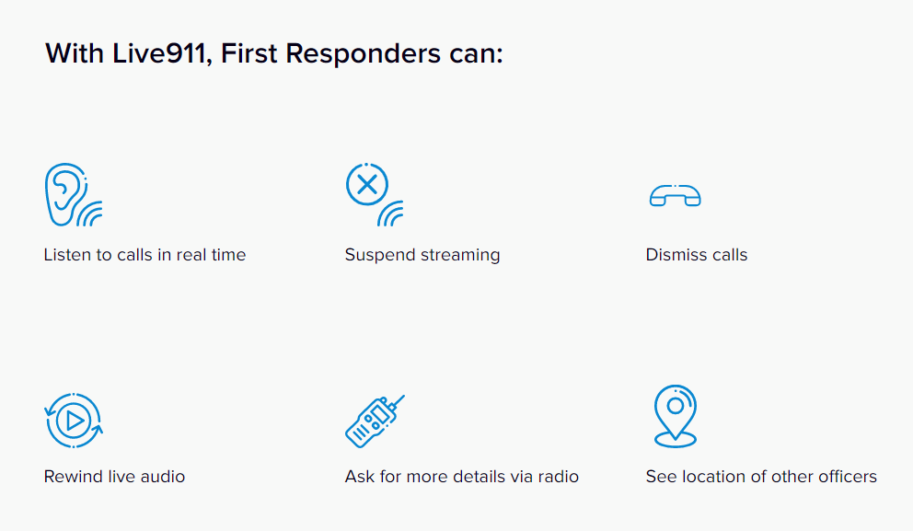
The Benefits

Slide 4
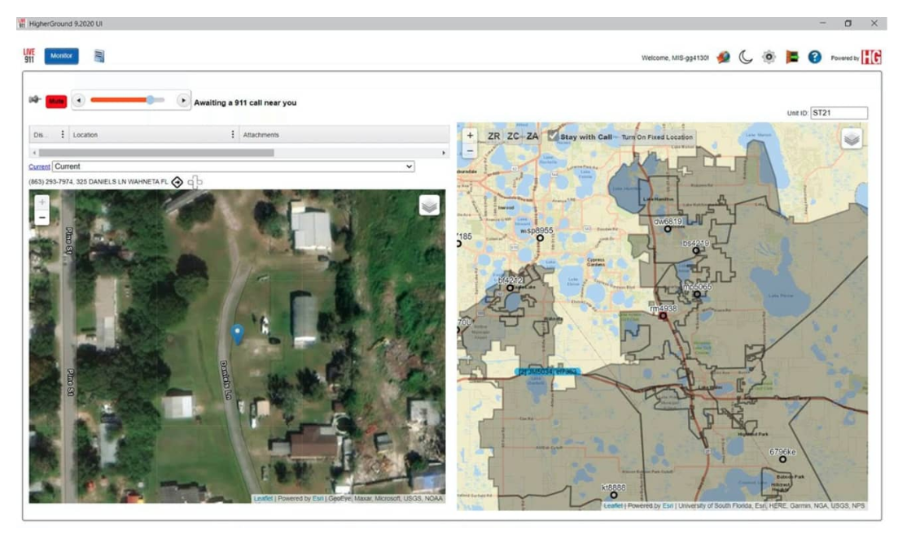
Integration

Slide 5
In the News

Slide 6
In the News

Slide 7
More Information
Website
https://live911.com/how-it-works/
https://live911.com/videos/

Slide 8
More Information
To Set Up A Demo Contact:
Bill Behar
940-231-0655

